Slide 1
MORNINGSTAR

Slide 2
INTRODUCTION
MorningStar is a premier event management website that offers exceptional solutions for creating unforgettable events.
With a range of event-specific information available on the website, clients can easily find important details such as the date and time of the event.
Whether it's a wedding, anniversary, birthday party, or baby shower, the website is equipped with various features to take orders and make the planning process a breeze.

Slide 3
EXISTING SOFTWARE SYSTEMS
Existing event management companies carries out booking,cancelling of the event manually.
It is required for the customers to give the call on given
contact number and book the event.
Now the drawbacks of the existing system can be stated in terms as follows:

Slide 4
LIMITATIONS OF EXISTING SOFTWARE SYSTEM
It is time consuming as the system is handled manually
Assurance of data security is not given.
Manpower requirement is low.
It is hectic to handle the huge transaction.

Slide 5
PROPOSED SYSTEM
Simple and user friendly.
Users get the information about the decoration at a single place.
Effective and saves time and cost
of the users.
Users can also check the availability and book
events according to their need.

Slide 6
ENTITY-RELATIONSHIP DIAGRAM
ER Diagram:-
An Entity Relationship Diagram is a diagram that represents relationships among entities in a database.
The ER Diagram is a structural design of the database.
It acts as a framework created with specialized symbols for the purpose of defining the relationship between the database entities.
ER diagram is created based on three principal components: entities, attributes, and relationships.

Slide 7
Entity:
An entity is a real-world object that has certain properties called attributes that define the nature of the entity. Entities are distinguishable, i.e., each entity in a pair of entities has a property that makes one entity different from the other entity.
Relationship:
Any association between two entity types is called a relationship. For
example, a mother feeds her baby. Here “feeds” is a relationship, and
this is the relationship between a child and the mother.
Attribute
An attribute is a piece of data that describes an entity. For example, in a customer database, the attributes might be name, address, and phone number. In a product database, the attributes might be name, price, and date of manufacture. Each attribute has a specific data type, such as string, integer, or date.

Slide 8
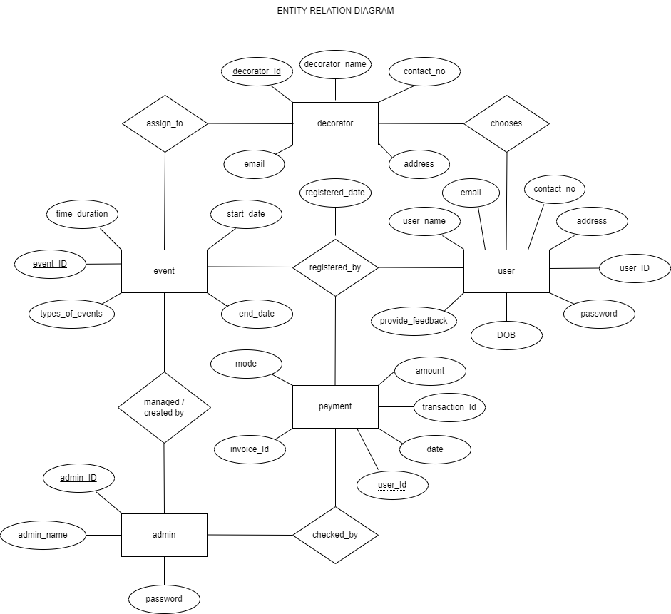

Slide 9
USE-CASE DIAGRAMS
Use-case diagrams illustrate and define the context and requirements of either an entire system or the important parts of the system.
You can model a complex system with a single use-case diagram, or create many use-case diagrams to model the components of the system.
You would typically develop use-case diagrams in the early phases of a project and refer to them throughout the development process.

Slide 10
Use cases
A use case describes a function that a system performs to achieve the user’s goal.
A use case must yield an observable result that is of value to the user of the system.
Actors
An actor represents a role of a user that interacts with the system that you are modeling.
The user can be a human user, an organization, a machine, or another external system.
Subsystems
In UML models, subsystems are a type of stereotyped component that represent independent, behavioral units in a system.
Subsystems are used in class, component, and use-case diagrams to represent large-scale components in the system that you are modeling.

Slide 11
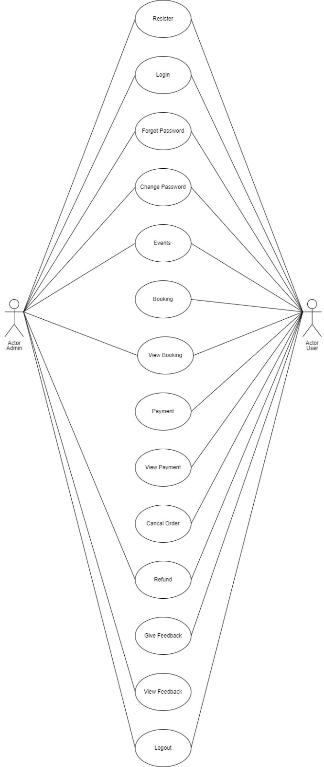

Slide 12
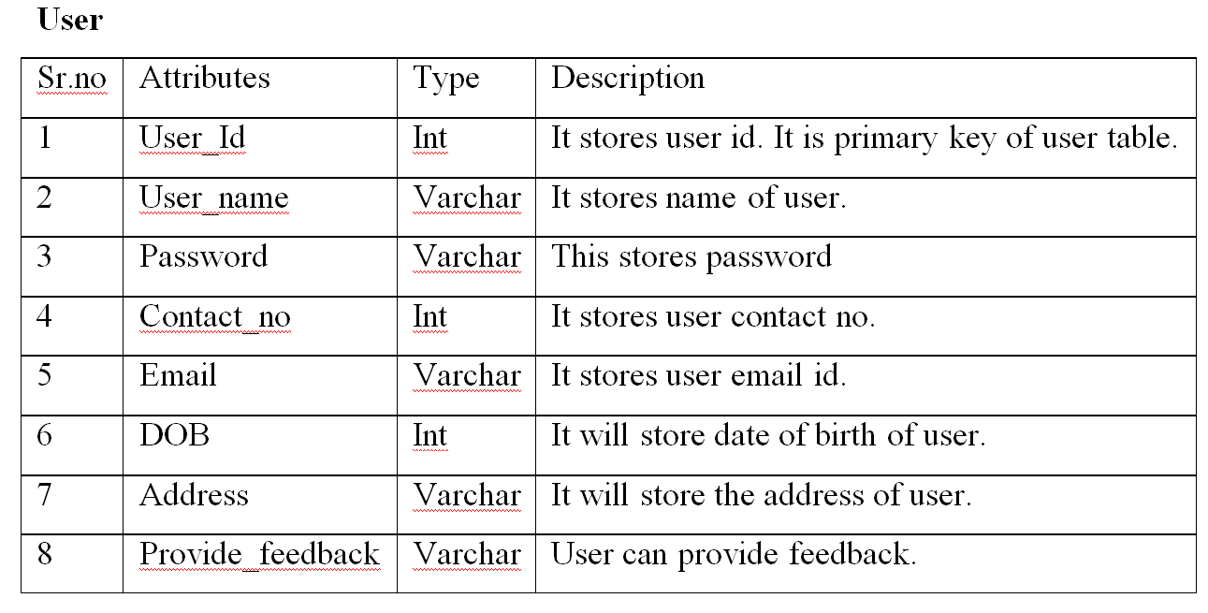
DATABASE SCHEMA

Slide 13
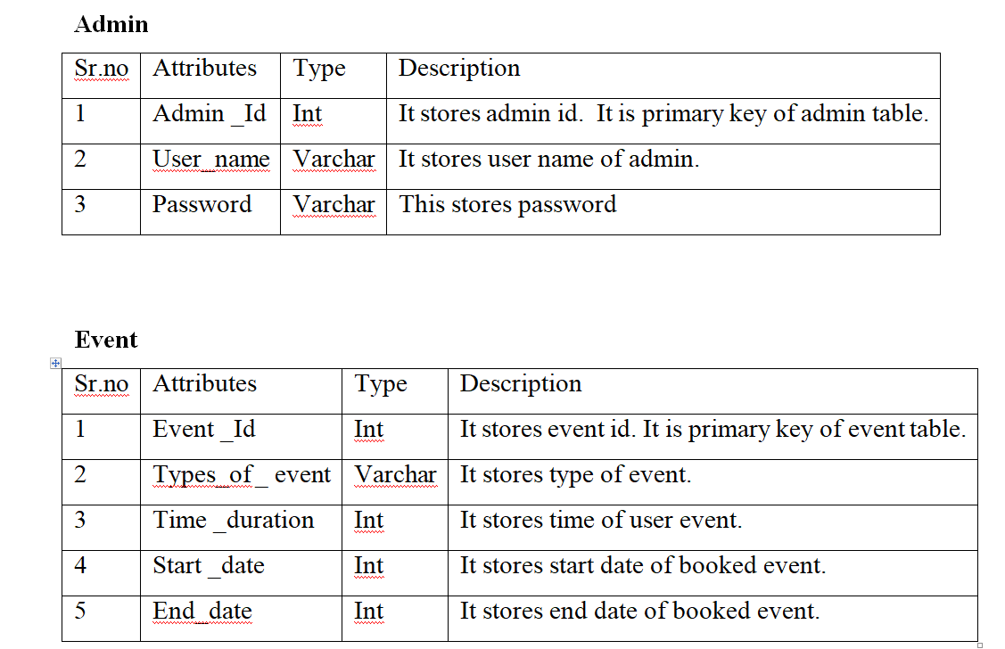

Slide 14
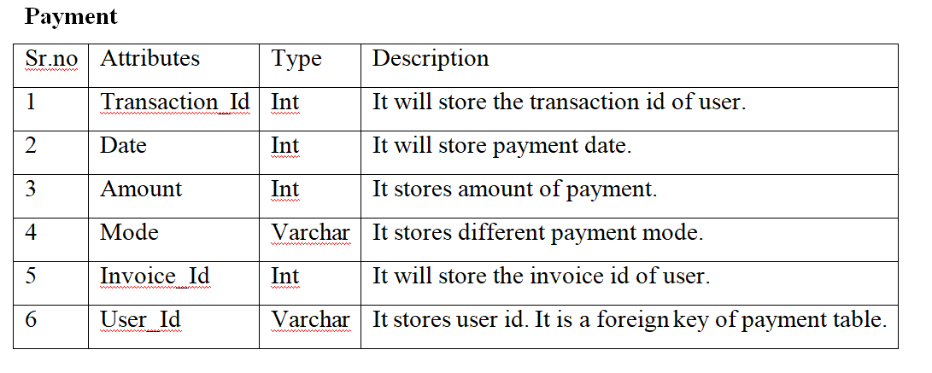


Slide 15
FRONT END SOFTWARE TOOLS
Front End Development Tool is a software application which helps developers to build attractive website layouts and apps with ease.
Those tools help to accelerate the web development process by providing drag and drop elements and various built-in features to create a more attractive web design layout.
HTML : HTML is used to create and save web document. Eg : Notepad/Notepad++
CSS : (Cascading Style sheets) Create attractive Layout
JavaScript : It is a programming language, commonly use with web browsers
React JS : React JS is a declarative, efficient, and flexible JavaScript library for building user interfaces.

Slide 16
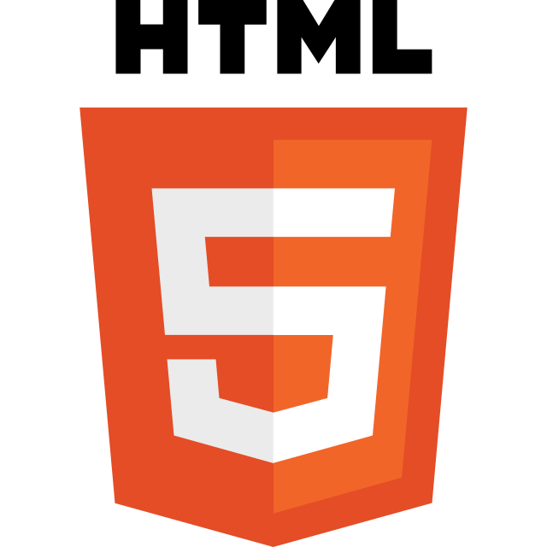
Hypertext Markup Language (HTML) :
HTML :
Stands for Hyper Text Markup Language.
HTML is the standard markup language for creating Web pages.
HTML describes the structure of a Web page.
HTML consists of a series of elements.
HTML elements tell the browser how to display the content.

Slide 17

Cascading Style Sheets (CSS) :
Cascading Style Sheets (CSS) is a stylesheet language used to describe the presentation of a document written in HTML or XML (including XML dialects such as SVG, MathML or XHTML).
CSS describes how elements should be rendered on screen, on paper, in speech, or on other media.

Slide 18

JavaScript (JS) :
JavaScript is a scripting language.
Enables you to create dynamically updating content, control multimedia, animate images, and pretty much everything else.

Slide 19
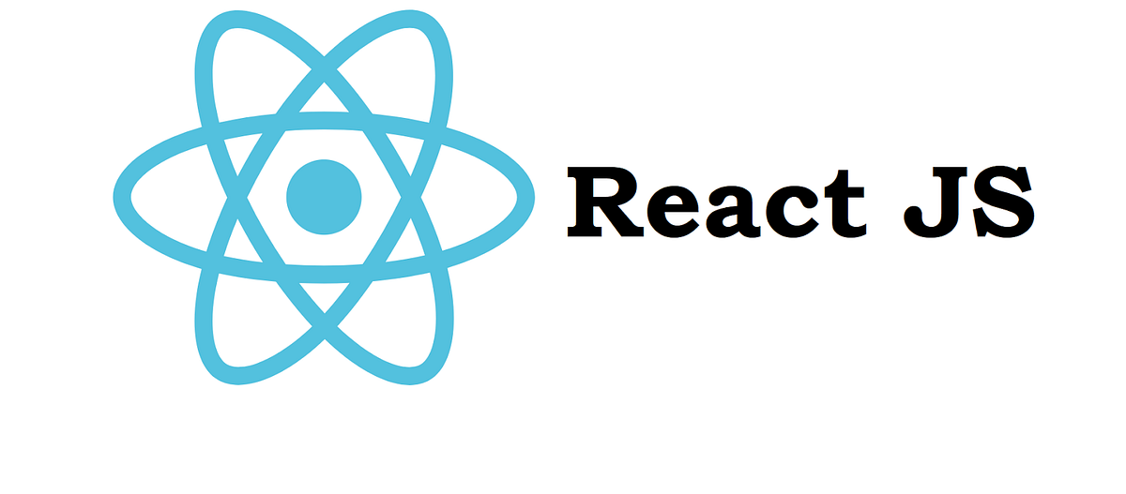
React JS
The React JS framework is an open-source JavaScript framework and library developed by Facebook.
It's used for building interactive user interfaces and web applications quickly and efficiently with significantly less code than you would with vanilla JavaScript.

